Slide 1
City of Silverton February 2024 Council Roles and Responsibilities
Notes:
How many of you have attended an LOC elected essentials before tonight?
How long have you served on council and in what positions?
Did any of you serve on any boards or committees or commissions prior to involvement in council?
Why did you get involved in local government?
Are things going well/poorly/not sure yet?
What do you think the qualities are of a high functioning council?

Slide 2
Topics Covered
Roles of City Council and Staff
Council
Mayor
Council President
City Manager
Group vs. Team
8 Habits of Effective City Councils

Slide 3
Defining Roles and Responsibilities
Question:
Where can you find where your role is defined?
- Charter (1985)
- City Council Rules of Procedure (Adopted 2004; Amended 2023)
- Ordinances / Resolutions
Notes:
How many of you know the role you are supposed to play and the responsibilities you have on City Council?
Where are the roles and responsibilities outlined?
Charter
Attributes of Council-Manager Form of Government

Slide 4
Form of Government
Question:
Who here knows what form of government Silverton has?
Answer:
Charter, Chapter III – Form of Government
is the Council-Manager Form
Notes:
Question: Who here knows what form of city government their city has?

Slide 5
City Council - Generally
Legislative Body
Example: Ordinances; Budget; Resolutions
Policy Makers/Visionaries
Example: Strategic planning; comprehensive plans
Centralized Power
Limited Hiring Authority
Example: City manager; city attorney; municipal judge; police/fire chief
Limited Administrative & Quasi-Judicial Powers
Examples: Orders; resolutions; license; appeals from land use decision or planning commission; personnel decisions; contract code disqualification appeals
Notes:
Question: does any one councilor have authority? No – council must act as a unit.
Question: does anyone here have a city where the mayor votes? What about only voting in a tie-breaker? Do they run city council meeting?
Question: how many councilors make up your council? Do you know how many it takes for a quorum?
Centralized Power. The power of the council is centralized. No one councilor, unless otherwise stated in the Charter, has any individual power. Your power comes from your collective authority – you cannot act alone; you must act in concert with one another. Elected b/c of one issue, your particular platform – if you want that to be the council position, you need to convince your fellow councilors.
Legislative Body. The Council is the legislative body of the city – this is your primary responsibility and duty. You are responsible for enacting ordinances, comprehensive plans, strategic plans, the budget. But again, you do it together – as a team. Budget is the biggest authority (although the least exciting).
Policy Makers/Visionaries. You guide the overarching policy of the city. You set the vision for where your city is going this year, and in some cases (particularly land use) the next 10 years. This does NOT mean the City Manager doesn’t make policy themselves, it means that whatever policy the manager makes, it must be based on or follow the overarching policy already established by the City Council.
*Council creates plan + budget → staff makes all the minor decisions to make that happen.
Limited Hiring Authority. City Councils typically have very little authority to hire, manage, discipline or fire city employees. Most cities in Oregon limit their city councils to hiring, managing, disciplining and firing the city manager, city attorney, municipal judge, and on occasion the police chief. In the smaller cities in Oregon, because the city does not have a city manager, the council is responsible for hiring, managing, disciplining and firing the recorder.
*Contractors different than staff.
Limited Administrative & Quasi-Judicial Powers. At times, councils will be asked to utilize both administrative and quasi-judicial powers. Administrative powers are twofold in nature.
First, when you enact a resolution, it’s generally considered administrative in nature. Or, when you must make a non-discretionary action – business license issuance.
Second, Quasi-judicial powers typically occur in the land use context and are when the council acts as a judge.
*ADVICE → seek out land use training, it is complex in Oregon. Ask city manager about continuing education on this topic.

Slide 6
Silverton City Council
Charter, Chapter III, Section 7: Council
The council shall consist of a mayor and six (6) councilmembers elected from the city at large
Charter, Chapter III, Section 8: Council Members
The term of office of each councilmember in office when this Charter is adopted shall continue for the term for which each was elected. At each subsequent biennial general election, three (3) councilmembers shall be elected, each for a term of four (4) years
Charter, Chapter IV, Section 14: Quorum
A majority of the incumbent members of the council shall constitute a quorum for its business, but a smaller number may meet and compel the attendance of absent members in a manner provided by ordinance

Slide 7
Silverton City Council
Council Authorities
Legislative:
Adopt Ordinances
Administrative
Appoint/Remove/Supervise City Officers
Adopt Resolutions
Quasi-Judicial
Council applies specific rule/policy, to a specific situation, council makes final decision, typically making specific findings.
Notes:
Code Chapter 2.08 - Planning Commission Power and Duties: The powers and duties of the Planning Commission are to recommend and make suggestions to the City Council and to all other public authorities concerning the laying out, widening, extending, parking, and locating of streets, sidewalks, and boulevards; the establishment of setback lines; the relief of traffic congestion; the betterment of housing and sanitation conditions; and the establishment of zones and districts limiting the use, height, area, and bulk of buildings and structures in accordance with Silverton Municipal Code; Title 18, Development Code and Zoning Map.
Additionally, the commission will recommend to the City Council and all other public authorities plans for the regulation of the future growth, development, and beautification of the city in respect to its public and private buildings and works, streets, parks, grounds, and vacant lots, and plans consistent with the future growth and development of the city in order to secure to the city and its inhabitants, sanitation, proper service of public utilities, and transportation facilities.
The commission will also do and perform any and all other acts and things necessary or proper to carry out the provisions of Chapter 2.08 of the Silverton Municipal Code. In general, the commission's role is to study and propose such measures as may be advisable for the promotion of the public interest, health, morals, safety, comfort, convenience, and welfare of the city.

Slide 8
Silverton City Council
Charter, Chapter III, Section 7 – Council
Council consists of (1) mayor and (6) councilmembers
Charter, Chapter III, Section 8 – Councilmembers
Councilmember term is four years duration
Charter, Chapter IV, Section 13 – Meetings
Minimum one meeting per month
Council shall adopt council rules
Ordinance 2.04 – City Council Meeting: City council meetings held first Monday of each month, at a time set by council
Charter, Chapter IV, Section 14 – Quorum
Majority of council members
Notes:
Council Meetings:
-Regular
- Special
-Emergency
- Work sessions
-adjourned meetings
- executive sessions

Slide 9
Silverton City Council
Charter, Chapter V, Section 26 – Interference in Administration and Elections
(1) Member of council shall not directly/indirectly/by suggestion attempt to influence the manager in making an appointment/removal of city staff, purchasing supplies, or quid pro quo for a management position.
(2) Member of council forfeits the office if they violate section (1)
Charter, Chapter VI, Section 30 – Oath of Office
Each officer shall take an oath to affirm support of the constitutions, the laws of the U.S., and the state of Oregon, and to faithfully perform office duties.

Slide 10
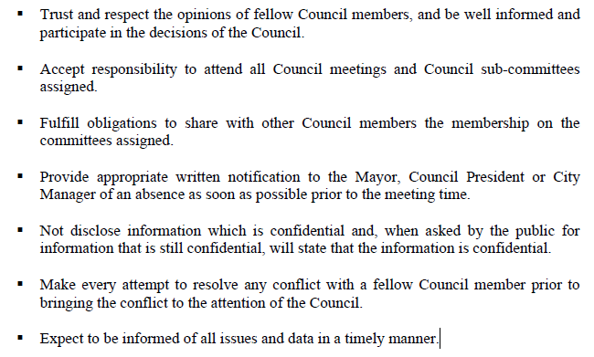
Silverton City Council
City Council Protocols - Page 6:
Council members will adhere to the adopted set of principles when dealing with each other and general public.
Council desires to conduct meetings that are courteous, effective, efficient.
Council desires to foster environment that is fair, open, and responsive to community needs.

Slide 11
Silverton City Council
COUNCIL MEETING EXPECTATIONS
▪ Try to make the citizens comfortable and part of the process at the meetings.
▪ Make visitors comfortable by being courteous, respecting their opinions, and by
showing trust and respect for visitors.
▪ Do my best to communicate in clear, concise and audible language and written
communications.
▪ Strive to maintain a tone of voice that is friendly and sincere.
▪ Honor and act on all requests for action and/or information in a timely and courteous
manner.
- City Council Protocols set forth tenants and philosophy for the council to uphold
▪ Discuss issues, but not personalities with non-Council members. After an issue has been voted on, a council member will communicate in a manner that does not undermine the integrity or motives of the Council.
- City Council Protocols: Page 6
Notes:
City Manager sending out working agreements for city council to consider to ascribe to in the future (similar to oath).

Slide 12
Silverton City Council
19. Non-Observance of Protocols and Guidelines – The adopted protocols and guidelines are adopted to expedite and facilitate the transaction of the business of the Council in an orderly fashion and will be deemed to be procedural only. Failure to strictly observe any such protocol or guideline will not affect the jurisdiction of, or invalidate any action taken by the Council. The Council will make every effort to comply with all protocols and guidelines within this document. All questions pertaining to the document regarding its’ protocols and guidelines must be resolved by a majority vote of the City Council.
21. Use of Handheld Electronic Devices During Council Meetings – The use of handheld electronic devices shall not interfere with the meeting.
- City Council Protocols, Page 16

Slide 13
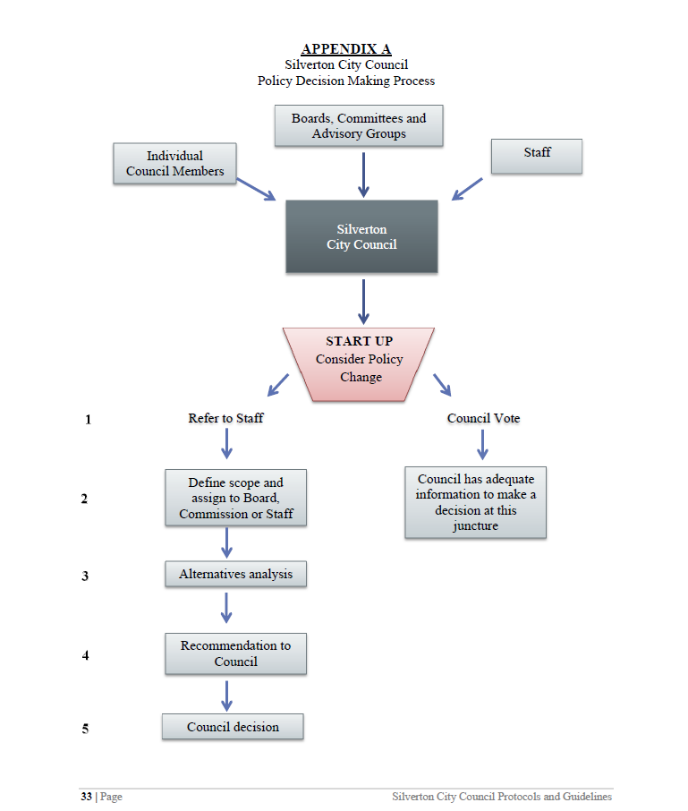
Silverton City Council
City Council Protocols: Pages 24-26; Appendix A: Policy Decision Making Process
Notes:
How many of you are familiar with this process?
Do you regularly follow this model?
Is it working? Is it helpful?

Slide 14
Mayor - Generally
Public Face of Community
Represent city at events
Council spokesperson
Presiding Officer
Keeps order
Sets agendas
Appoints committee members
Signs documents and ordinances
Chief Facilitator
Facilitates discussions between councilors
Facilitates dialogue between council and manager

Slide 15
Silverton Mayor Duties
Charter, Chapter III, Section 9 – Mayor
Two-year term
Charter, Chapter IV, Section 17 – Mayor at Council Meeting
Shall preside over council deliberations
Shall have vote on all questions before council
Shall preserve order, enforce council rules
Shall determine order of business
Charter, Chapter V, Section 20 – Mayor
Shall appoint council committees
Shall sign all records of proceeding, countersign all orders of city treasurer
Shall have NO veto power
Shall sign all ordinances passed by council within three days of passage.
Notes:
Is there a routine meeting between mayor and city manager?
Does the Mayor have routine meetings with individual councilors?

Slide 16
Silverton Mayor Duties
Council Protocols, Chapter I, Section 8
Establishes protocol if mayor is absent
Council Protocols, Chapter III
Mayor to Facilitate Council Meetings: prevent misuse of motions, abuse privilege or obstruction of business
Mayor shall act in good faith
Assist council to focus on agenda, discussions, and deliberations
Manage councilmembers discussion
Council Protocols, Chapter III, Section 9
(a)-(k) – prescribes format for agenda item discussion protocols
Council Protocols, Chapter VII, Section 1 and 2
Ceremonial Representative: proclamations, certificates of recognition
Notes:
Is there a routine meeting between mayor and city manager?
Does the Mayor have routine meetings with individual councilors?
Council Protocols, Chapter III, Section 9
9. Discussion – The following basic format should be followed for discussion on each item
on the agenda. The Mayor will:
a. Announce the agenda item, sometimes by number, clearly stating the subject of
the issue. If it is a public hearing open the public hearing.
b. Invite reports from staff, advisory committees, or other persons charged with
providing information to the Council.
c. Ask if any Council Members have any technical questions that require
clarification.
d. Ask for public comments or, if when the item is a public hearing invite the
appellant then the applicant and lastly the public to provide testimony as
described in Section V. At the end of the public comment section announce that
public input has concluded or the public hearing has ended. The balance of the
discussion will be limited to the members of the Council, unless the Council
waives this rule by majority vote.
e. Invite a motion from the Council and recognize/announce the name of the
member making the motion and then the person seconding the motion.
f. Ensure that the motion is clearly understood, either by repeating it or by asking
the clerk or the author of the motion to repeat it.
g. Ask if there is further discussion on the motion before the Council.
h. Moderate any further discussion if needed, allowing for normal and reasonable
debate, on the motion or any proposed amendments before the question is called.
i. Determine that the motion is ready for a vote.
j. Call for the vote.
k. Announce the result of the vote.

Slide 17
Silverton Mayor Duties
Council Protocols, Chapter X, Section 4
Adherence to Administrative Procedure & Process Protocols
Mayor has duty to discuss (on behalf of council) any perceived/inappropriate administrative action with a council member
Mayor will discuss with said council member the action at issue and suggest a more appropriate process or procedure to follow
Mayor will report the concern to the full council

Slide 18
Council President - Generally
Acts as the Mayor when the Mayor is absent
In some cities, the Council President is elected to represent and be the head of the Councilors
Depending on charter or council rules, some Council Presidents retain authority to vote when acting as Mayor

Slide 19
Silverton Council President Duties
Charter, Chapter IV, Chapter 18 – Council President
First meeting of each odd-numbered year, council shall elect council president
Shall cast single vote on any single issue
Whenever mayor is unable to perform functions of office, the president shall act as mayor
Council Protocols, Chapter I, Section 8 –
Council president shall preside in absence of mayor
Council Protocols, Chapter VII, Section 1 and 2 –
Council President assumes responsibilities of mayor in their absence

Slide 20
City Manager- Generally
Chief Executive Officer of the City
Manages the city and its personnel
Recruits, hires, supervises and terminates city employees
Prepares the budget (or oversees its preparation) for the council’s consideration
Responsible for ensuring the council’s vision and strategic plans are brought to fruition
Chief Advisor to the City Council
Provides the council with objective information about local operations
Provides reasoned analysis and assessments of the benefits and consequences of city council actions
Makes policy recommendations for the council to consider
Notes:
Administrative role:
Assisting functions of city gov’t and council
Provide info to council to assist in decision making
Some cities grant city-manager some autonomous decision power
Chief policy advisor → PAID TO ADVISE
Other Duties: economic development, foster/build relationships; day to day activity decisions; contract decisions (up to X amount); manage citizen reports

Slide 21
Silverton City Manager Duties
Charter, Chapter III, Section 10 – Appointive Officers
Council shall appoint City Manager / Recorder by majority vote
Shall affix compensation and approve for city employees
Charter, Chapter V, Section 22 – City Manager
Indefinite term
Charter, Chapter VI, Section 31 – Nominations
City Recorder serves as elections officer

Slide 22
Silverton City Manager Duties
Charter, Chapter V, Section 24 – Powers and Duties of City Manager
City CEO
Appoints all heads of departments
Supervises city employees
Ensures contracts, franchises, leases, permits are fully observed
Attends all council meetings
Advise council of city needs
Prepare and furnish reports as council requests
Oversees city supply purchasing; contracts
City recorder
The list goes on…..

Slide 23
Silverton City Manager Duties
Council Protocols
Chapter II and Chapter VII– Manager can add consent agenda items as well as regular agenda
Chapter IV, Section 2 – Mayor may assign city manager follow up duties during public comment and direct for additional information to be brought to council at a later meeting
Chapter VI, Section 3 – Mayor can direct City Manger to respond directly to public commentor or revisit at later meeting if correction required

Slide 24
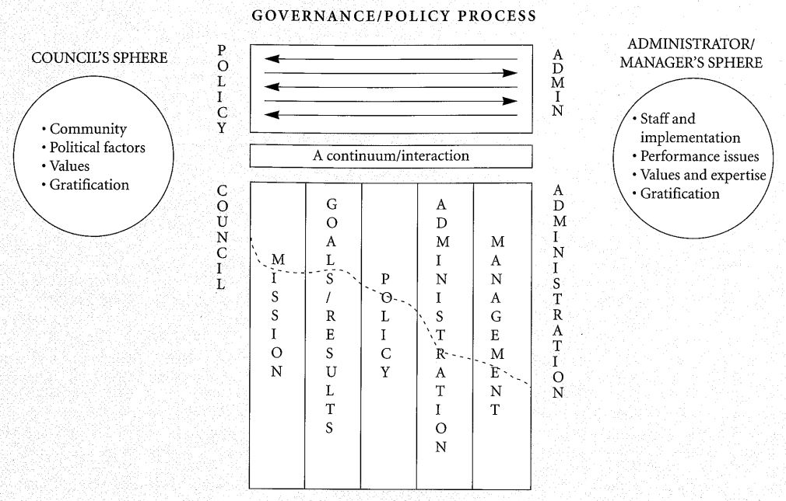
Council - City Staff PARTNERSHIP
Notes:
Council + staff = symbiotic relationship.
Council takes input and guidance from the City Manager and other City staff.
City Manager implements the Council’s policy, but in developing the policy, the Council may define the parameters it seeks to achieve.
EXAMPLE: council passes water line/infrastructure project → city manager and staff makes that happen.

Slide 25
GROUP
vs.
TEAM
Notes:
Does this photo depict a group or a team? Why?
What makes a group versus what makes a team?
Why is a team better than a group?
Can a group become a team? How?
Flight attendants vs. passengers.

Slide 26
GROUP VS. TEAM
GROUP
TEAM
Consists of people who are independent of each other and each member has a different set of tasks.
Because members work individually, their work product is also valued independently.
Consists of people and tasks that are interdependent and rely on each other.
People are dependent on one another, share responsibilities and are judged as a collective.
Buy into the theory of governance.
Notes:
Group = independent work vs. Team = Interdependent work as a collective
Do you think your council is working more as a group or a team?
Your council will be judged as a unit – it is unlikely that a single council member will be identified as the reason a decision was or was not made. It will be the team judged as a unit.

Slide 27
BUILDING A TEAM
Communication
Question:
What do you think it takes to build a productive team?
Respect
Goals
Question:
What things can your council do to foster a better team?
Knowledge

Slide 28
TEAM PRINCIPLES
Shared Understanding
Shared Ownership
Everyone Contributes
Room for Everyone to Express Ideas & Opinions
No Person Feels Threatened by Conflict
Atmosphere of Trust & Encouragement
Participative Decision-Making
Notes:
Please share your thoughts on how your council incorporates any of these principles?
Where is there room for improvement?
What specifically can be done to improve that principle?
There is a shared understanding between the members that personal and team goals can be achieved best with mutual support.
How many of you have read your charter/ordinances/council rules and procedures/policies?
Members feel a shared ownership of their work and the team’s goals and are committed to the commonly established (explicit or implicit) rules.
This can be difficult – this will come up when there is a split vote → as a whole council, after a vote, each councilor must subscribe to the result.
Everyone can contribute their personal or professional competencies to the success of the team’s goals.
Group projects Hypo → how many of you were assigned to group projects….how many enjoyed/hated? Why?
There is room to express ideas and opinions, and team members are making effort to understand each other.
Even if there is one councilor who has an opinion/thoughts/comments on each council item → allowing space and inviting all voices to be heard will make a more successful council.
Nobody feels threatened by conflict and conflict is viewed as a normal aspect of teamwork.
Councils are political, but also non-partisan.
There is an atmosphere of trust and encouragement, and members are encouraged to improve their skills and competencies.
The decision-making process is participative and no one is left out or unheard.
Progress the discussion but PARTICIPATING.
Remember: city staff plays a very important role.
According to Robert Maddux, author of Team Building: An Exercise in Leadership and a respected leader in effective teambuilding, these are the 7 principles to keep in mind when a group is trying to become a team

Slide 29
9 Habits of Highly Effective Councils
Think and act strategically
Master Group Decision Making
Understand and demonstrate teamwork
Define roles and responsibilities
Seek objective assessments
Effective Councils
Continue education
Adopt, apply, adhere to procedure rules
Allocate time appropriately
Evaluate policy implementation
Notes:
Can your council implement any of these….how?
What does your council do well already from this list?

Slide 30
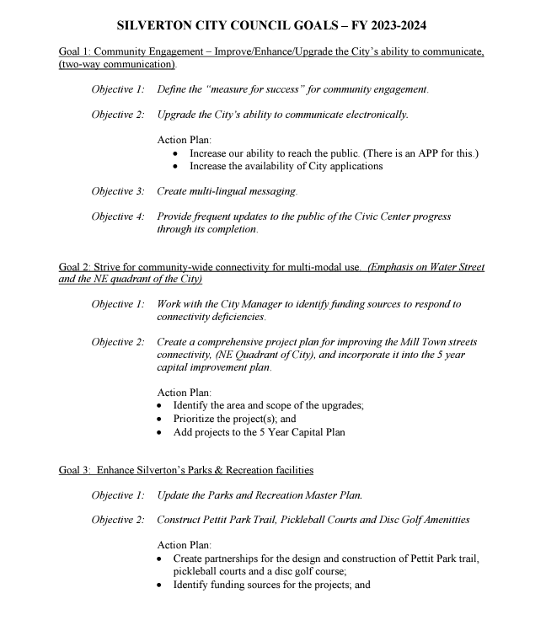
Think and Act Strategically
Council Protocols Chapter X, Page 31
The Council will review, and revise and City Council Protocols and Guidelines as needed or every two years
Notes:
Were any of you on council when these goals were set?
Do these goals still resonate with this current council?
Do you have goal setting in the near future?
Do you evaluate your success of these previous goals set?

Slide 31
Think and Act Strategically
February 6, 2024 – work session to review current goals.
How does your council monitor progress on any given goal?
Monthly, quarterly, mid-year check-ins?
Who was present during the last goal setting session?
Notes:
You have an upcoming strategic planning session scheduled.
Thinking as a group and working together to make achievable goals and visions for the City are important.

Slide 32
Think and Act Strategically
Adopted July 1979
Last revised August 2002
Periodic Review required by 2007 legislation for cities over 10,000.
The overall purpose of Periodic Review is to ensure that local comprehensive plans are:
Updated to respond to changes in local, regional and state conditions;
Coordinated with other comprehensive plans and investments; and
In compliance with the statewide planning goals, statutes and rules.
Notes:
SILVERTON, OREGON
Adopted July, 1979
Revised July, 1980
Revised July, 1989
Revised November 2000
Revised August 2002
- Periodic Review required by ORS Chapter 197

Slide 33
Understand and Demonstrate Teamwork
What does demonstrating teamwork look like?
Goals; understood roles; climate of trust and mutual respect; disciplined leadership; commitment to team’s success.
Question:
Does your council currently demonstrate teamwork? What does that look like?
Question:
What would you like to see implemented in the future to develop teamwork?
https://sidecarglobal.com/organizational-culture/place-process-dei-and-wellness-workplace-culture-in-2023/

Slide 34
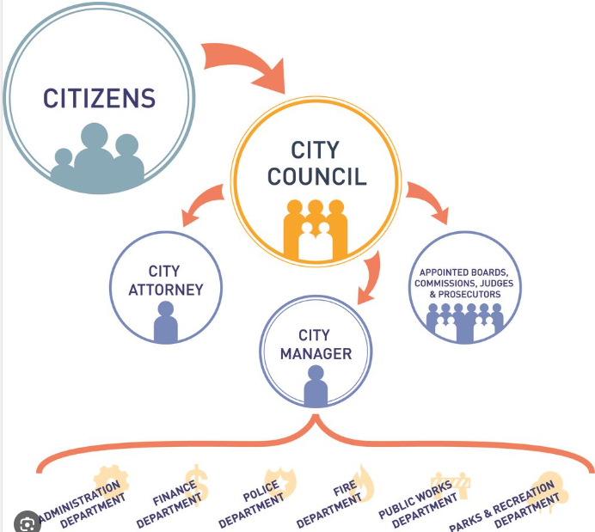
Define Roles and Responsibilities
Familiarity with your role
Know the basic functions of government
Continue to learn
Review governing documents regularly no matter how long you’ve been an elected official
Figure Credit to West University Place

Slide 35
Consistently Evaluate Policy Implementation
Who provides updates of your overall progress?
What frequency?
Is there a practice of feedback to each other and to city staff related to policy?
What frequency?

Slide 36
Allocate Time Appropriately
Goal Setting
(Annually)
Exploration & Analysis
(Work Session)
Disposition & Legislation
(Public Meetings)
Community Relations
(Town hall; city newsletters)
Notes:
Council has four arenas.
Goal Setting. You should do this at least annually. While your strategic plan may be five or 10 years in nature, you should evaluate it each year and see which goals you can accomplish that year.
Strategic and plan for 5-10 years
Exploration and Analysis. Work sessions or study sessions as they are often called are super helpful. These are intended to be meetings where councilors and experts confer with one another on significant items under consideration. These meetings are public, but the public watches, they don’t participate.
Work sessions
Disposition & Legislation. These are your council public meetings. This is where you debate and vote, it’s not the time to carefully analyze the issue – that already happened in your work session.
Make ordinances
Community Relations. While it sometimes pains people to hear the words “you work for me”, in reality we all do. You work for and represent your community members, as such, you need to form relationships with them and engage them. It doesn’t mean you do what they say, but you do engage and work with them.
Engage (e.g. coffee with mayor); town halls; city newsletters/comment cards
Question: how many of you elected, get paid? Typically, if not volunteers, get a nominal stipend. YOU MUST MANAGE YOUR TIME.
Cannot fix every issue.
Have due diligence and then make informed decisions.

Slide 37
Adopt, Apply, Adhere to Procedural Rules
When was the last time you reviewed your adopted your city council protocols and guidelines?
Presiding officers: mayor and council president – are you comfortable in your role of running meetings?
If not, what can you do to feel more comfortable?
Councilors: are you familiar with your role to help meetings run efficiently?
If not, what can you do to support your council?
Notes:
Question: who has read their council rules/procedures? How often?
The council rules/procedures create structure and fairness. / If the rules are known, understood, implemented each meeting → fosters collegiality.
If no rules: deterioration happens.
EXAMPLES: interrupting people; multiple talking over each other; question time turns to debate time; the public gets involved outside its designated time; facilitators become participants, etc…
**As a council you can review, re-write the council rules/procedures; can address bad behaviors.

Slide 38
Seek Objective Assessments
https://www.culturemonkey.io/employee-engagement/dei-training/
This Photo by Unknown Author is licensed under CC BY-SA
Notes:
Elections
Surveys
Monthly updates to public
Questionnaires
Newsletters
Coffee with Mayor

Slide 39
Continue Education
LOC Trainings and Conferences
Elected Essentials
Municipal Fundamentals
On-Demand Trainings
Small Cities Meetings
Lobbying 101 Videos
City Day (odd years)
Conferences
Spring Conference (Klamath Falls)
Fall Conference (Bend)
Scholarships
Bulletin
Local Focus
Reference Library
Municipal Handbook
CityCounty Insurance Services (CIS)
Identify Your Role
What are the Skills Needed?
Develop Skills
Learn as a Group

Slide 40
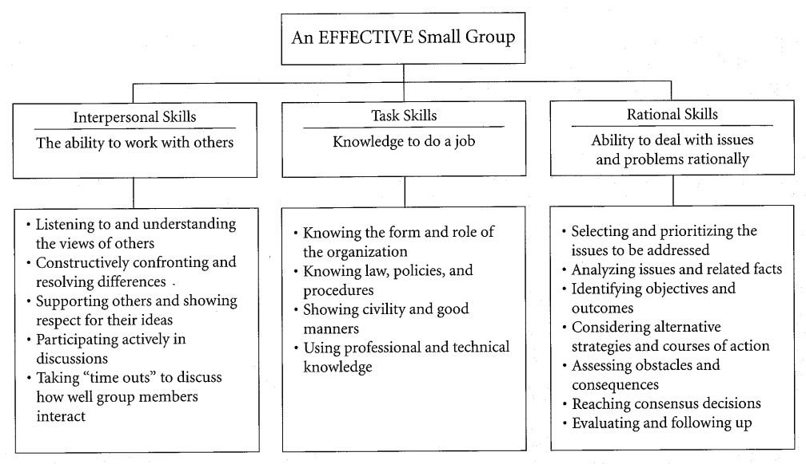
Master Group Decision Making
Create clearly defined processes for making decisions
Each member of the group identifies strength and weakness and improves where they can
Group supports the collective goals
Figure credit goes to Carl H. Neu, Jr

Slide 41
QUESTIONS?

Slide 42
League of Oregon Cities
Call: (503) 588-6550
Email:
Robin Klein
Assistant General Counsel
rklein@orcities.org

